Slide 1
Lecture 09: Top-Down Parsing
Lecture 09 - Top-Down Parsing

Slide 2
Left Recursion
A grammar is left recursive if for any nonterminal A such that there exists any derivation A ⁺=> Aα for any string α
Most top-down parsing methods can not handle left-recursive grammars
Lecture 09 - Top-Down Parsing

Slide 3
Eliminating Left Recursion (1)
A → Aα₁ | Aα₂ | … | Aα_{m} | β₁ | β₂ | … | β_{n}
A → β₁A’ | β₂A’ | … | β_{n}A’
A’ → α₁A’ | α₂A’ | … | α_{m}A’ | ε
Harder case:
S → Aa | b
A → Ac | Sd | ε
Lecture 09 - Top-Down Parsing

Slide 4
Eliminating Left Recursion (2)
First arrange the nonterminals in some order A₁, A₂, … A_{n}
Apply the following algorithm:
for i = 1 to n {
for j = 1 to i-1 {
replace each production of the form A_{i} → A_{j}γ
by the productions A_{i} → δ₁γ | δ₂γ | … | δ_{k}γ,
where A_{j} → δ₁ | δ₂ | … | δ_{k} are the A_{j} productions
}
eliminate the left recursion among A_{i} productions
}
Lecture 09 - Top-Down Parsing

Slide 5
Left Factoring
Rewriting productions to delay decisions
Helpful for predictive parsing
Not guaranteed to remove ambiguity
A → αβ₁ | αβ₂
A → αA’
A’ → β₁ | β₂
Lecture 09 - Top-Down Parsing

Slide 6
Limitations of CFGs
Can not verify repeated strings
  Example: L₁ = {wcw | w is in (a|b)*}
  Abstracts checking that variables are declared
Can not verify repeated counts
  Example: L₂ = {a^{n}b^{m}c^{n}d^{m} | n≥1 & m≥1}
  Abstracts checking that number of formal and actual parameters are equal
Therefore, some checks put off until semantic analysis
Lecture 09 - Top-Down Parsing

Slide 7
Top Down Parsing
Can be viewed two ways:
  Attempt to find leftmost derivation for input string
  Attempt to create parse tree, starting from at root, creating nodes in preorder
General form is recursive descent parsing
  May require backtracking
  Backtracking parsers not used frequently because not needed
Lecture 09 - Top-Down Parsing

Slide 8
Predictive Parsing
A special case of recursive-descent parsing that does not require backtracking
Must always know which production to use based on current input symbol
Can often create appropriate grammar:
  removing left-recursion
  left factoring the resulting grammar
Lecture 09 - Top-Down Parsing

Slide 9
Transition Diagrams
For parser:
  One diagram for each nonterminal
  Edge labels can be tokens or nonterminal
    A transition on a token means we should take that transition if token is next input symbol
    A transition on a nonterminal can be thought of as a call to a procedure for that nonterminal
As opposed to lexical analyzers:
  One (or more) diagrams for each token
  Labels are symbols of input alphabet
Lecture 09 - Top-Down Parsing

Slide 10
Creating Transition Diagrams
First eliminate left recursion from grammar
Then left factor grammar
For each nonterminal A:
  Create an initial and final state
  For every production A → X₁X₂…X_{n}, create a path from initial to final state with edges labeled X₁, X₂, …, X_{n}.
Lecture 09 - Top-Down Parsing

Slide 11
Using Transition Diagrams
Predictive parsers:
  Start at start symbol of grammar
  From state s with edge to state t labeled with token a, if next input token is a:
    State changes to t
    Input cursor moves one position right
  If edge labeled by nonterminal A:
    State changes to start state for A
    Input cursor is not moved
    If final state of A reached, then state changes to t
  If edge labeled by ε, state changes to t
Can be recursive or non-recursive using stack
Lecture 09 - Top-Down Parsing

Slide 12
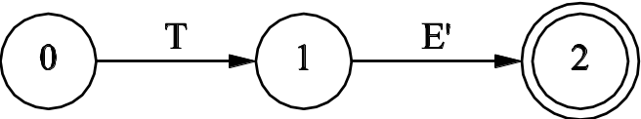
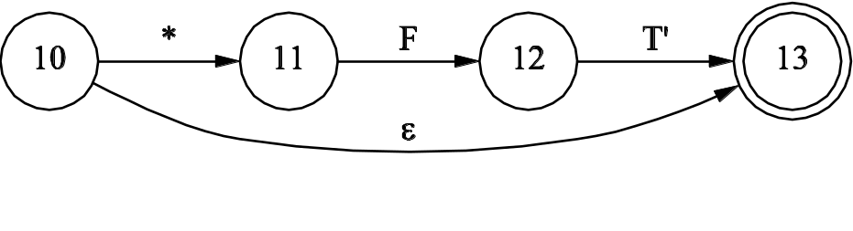
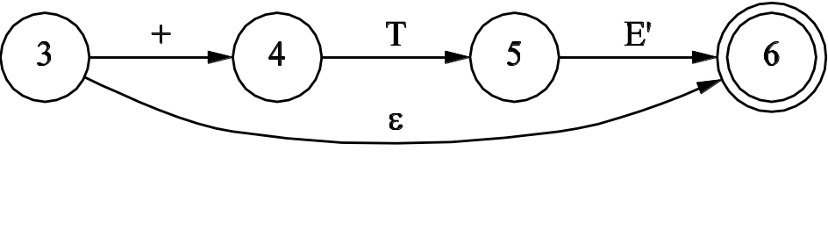
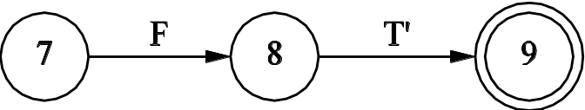
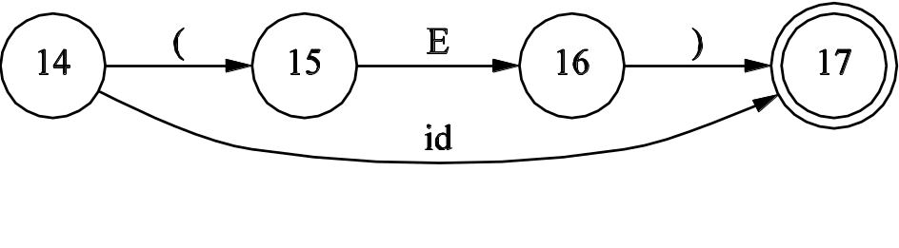
Transition Diagram Example
E → TE’
E’ → +TE’ | ε
T → FT’
T’ → *FT’ | ε
F → (E) | id
E → E + T | T
T → T * F | F
F → (E) | id
E:
T’:
E’:
T:
F:
Lecture 09 - Top-Down Parsing

Slide 13
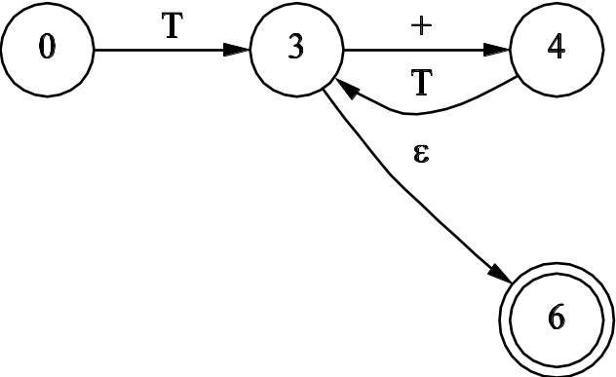
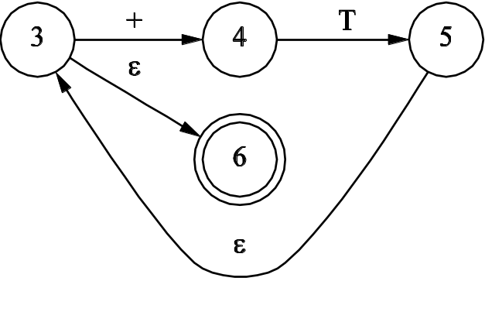
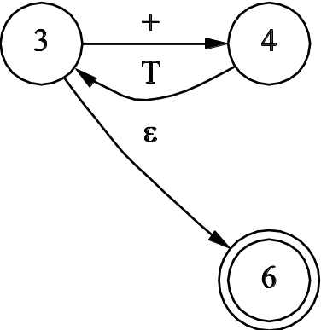
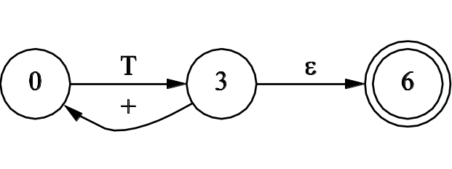
Simplifying Transition Diagrams
E’:
E:
Lecture 09 - Top-Down Parsing

Slide 14
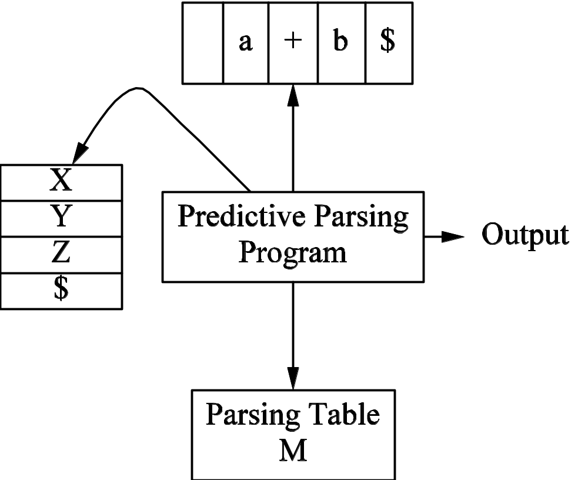
Nonrecursive Predictive Parsing (1)
Input
Stack
Lecture 09 - Top-Down Parsing

Slide 15
Nonrecursive Predictive Parsing (2)
Program considers X, the symbol on top of the stack, and a, the next input symbol
If X = a = $, parser halts successfully
if X = a ≠ $, parser pops X off stack and advances to next input symbol
If X is a nonterminal, the program consults M[X, a] (production or error entry)
Lecture 09 - Top-Down Parsing

Slide 16
Nonrecursive Predictive Parsing (3)
Initialize stack with start symbol of grammar
Initialize input pointer to first symbol of input
After consulting parsing table:
  If entry is production, parser replaces top entry of stack with right side of production (leftmost symbol on top)
  Otherwise, an error recovery routine is called
Lecture 09 - Top-Down Parsing

Slide 17
Predictive Parsing Table
Nonter-minal | Input Symbol
 | id | + | * | ( | ) | $
E | E→TE’ |  |  | E→TE’
E’ |  | E’→+TE’ |  |  | E’→ε | E’→ε
T | T→FT’ |  |  | T→FT’
T’ |  | T’→ε | T’→*FT’ |  | T’→ε | T’→ε
F | F→id |  |  | F→(E)
Lecture 09 - Top-Down Parsing

Slide 18
Using a Predictive Parsing Table
Stack | Input | Output
$E | id+id*id$
$E’T | id+id*id$ | E→TE’
$E’T’F | id+id*id$ | T→FT’
$E’T’id | id+id*id$ | F→id
$E’T’ | +id*id$
$E’ | +id*id$ | T’→ε
$E’T+ | +id*id$ | E’→+TE’
$E’T | id*id$
$E’T’F | id*id$ | T→FT’
Stack | Input | Output
… | … | …
$E’T’id | id*id$ | F→id
$E’T’ | *id$
$E’T’F* | *id$ | T’→*FT’
$E’T’F | id$
$E’T’id | id$ | F→id
$E’T’ | $
$E’ | $ | T’→ ε
$ | $ | E’→ ε
Lecture 09 - Top-Down Parsing

